Slide 1
MP0- Platform Introduction
Nathan Thoms, Taylor Johnson, Jack Cassidy, John Lavigne

Slide 2
Challenges: Level 1 - Debugging Hardware
Setting up the ILA core
JTAG clock frequency
Understanding how to use the Logic Analyzer
Setting the trigger
A lot of time was spent on configuring the logic analyzer to see that we could get an output
Notes:
We spent a lot of time trying to figure how we would debug through our hardware using the vivado logic analyzer. It took a lot of time to figure out how we can get any outputs from the logic analyze because for the most part we were getting issues that said the debug hub core was not detected and it took a lot of time and understanding of the system how it would work and how we can get outputs that would benefit us.

Slide 3
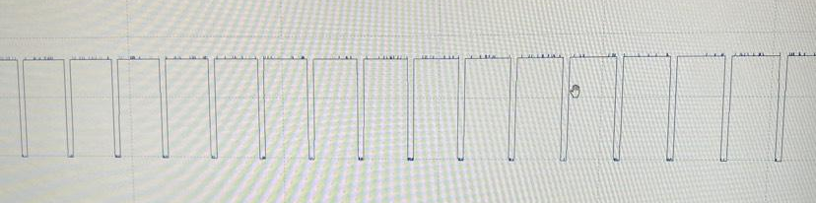
Challenges: Level 10 Boss - Timing Issues
Getting the Monitor to Display
Troubleshooting:
Logic Analyzer
Connect the Picoscope to the VGA output pins
Check clock connections → 25MHz
Solution:
Use the default settings in the Video Timing Controller

Slide 4
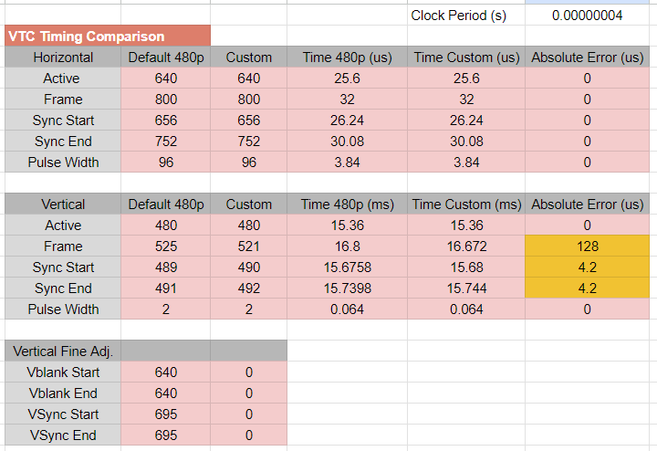
How much were we off from a working display?
Roughly 4.2 us shift in the sync pulse
Turns out the frame width timing was better for Custom timing when compared to VGA standard.

Slide 5
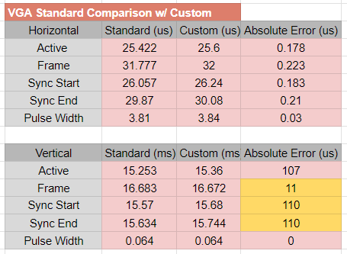
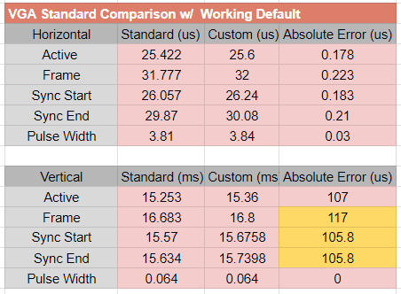
Comparisons to VGA Signal 640x480 @ 60 Hz Industry Standard Timing
Our vertical frame rate was closer to the 60 Hz target frequency.
The vertical synchronization pulse relative to the start of the frame was 4.2 us worse.

Slide 6
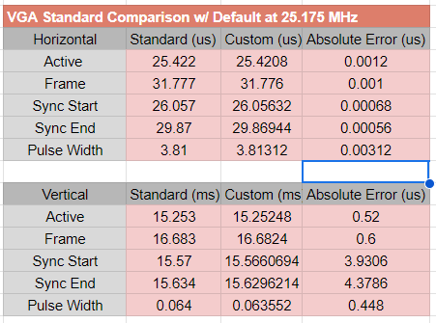
Optimal settings
Default VTC 480p settings
As close as you can get to 25.175 Mhz with Clock Wizard

Slide 7
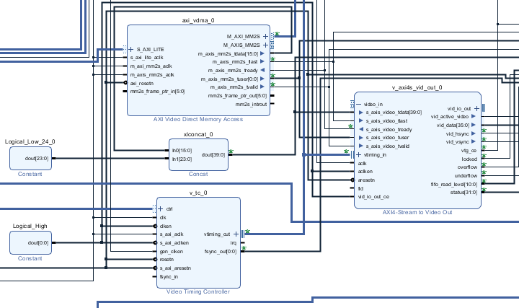
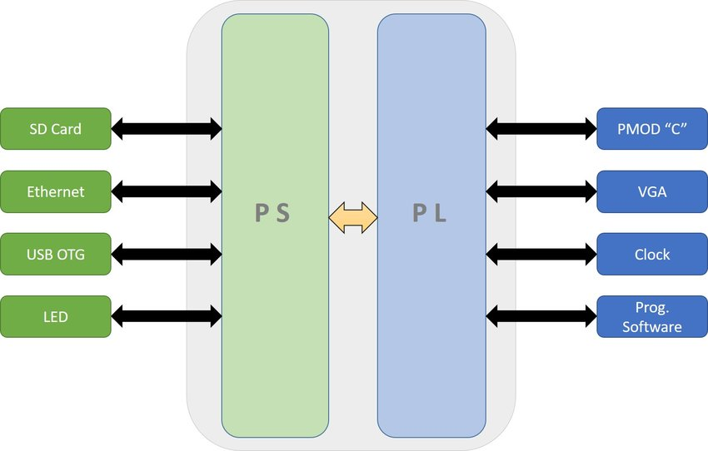
Areas of Interest:
Upsides and downsides of PL vs PS subsystems
Complexity of VGA output
Building custom hardware and then writing code to interface between them
Notes:
PL is good for static parallel tasks and peripheral controls (such as what we did in this lab)
PS are best for dynamic tasks and complicated logic controls

Slide 8
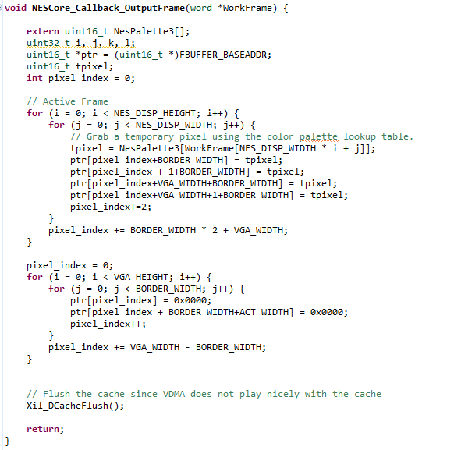
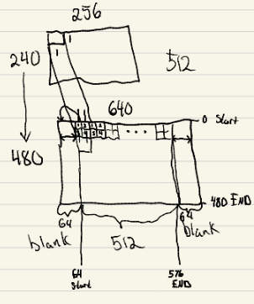
Lessons: EXP Gained
Pixel Mapping from 256x240 to 640x480
Draw it :)
Break down the problem

Slide 9
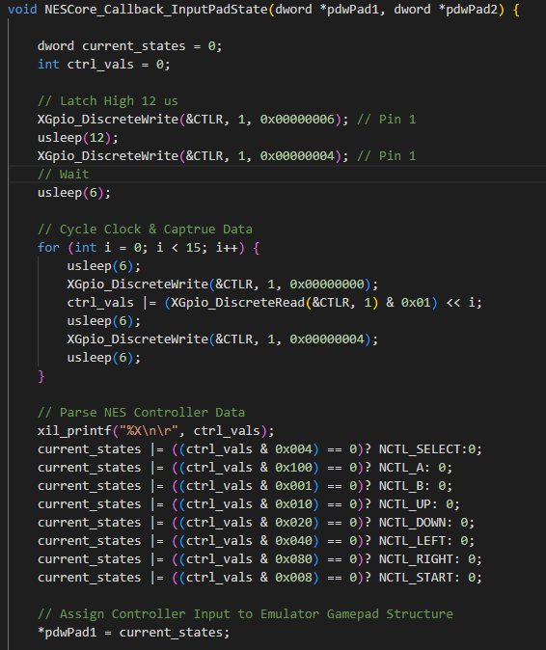
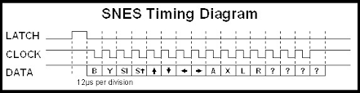
Using SNES Controller
Vivado - Axi_GPIO IP configured for tri state and constrained to PMOD JA pins.
Vitis - Configured tri state pins; data input and clock/latch output
Vitis - Updated NESCore_Callback_InputPadState() to drive the pins according to the SNES Timing diagram and captured the data.

Slide 10
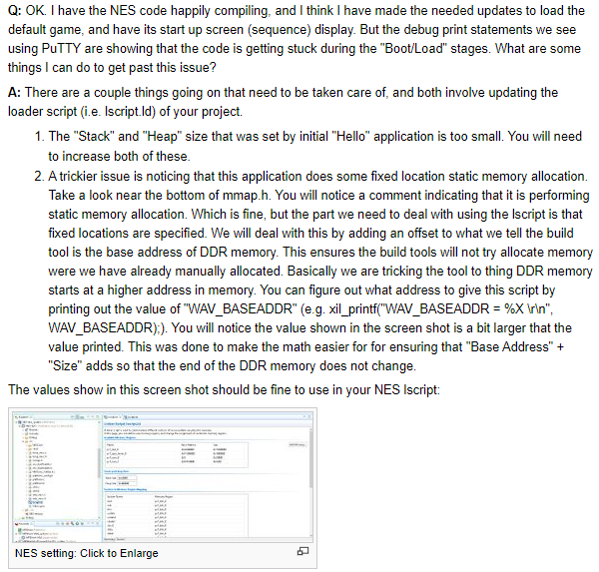
Lessons: EXP Gained
Vitis workspace path must not contain spaces
Converting the RGB hex values
Equation to go from an 8-bit to a 4-bit value
Rounding vs Truncating
Converting the RGB hex values
Connecting the PS push buttons
Include the xgpiops library to aid configuration
Platform tools
Use the wiki

